Slide 1



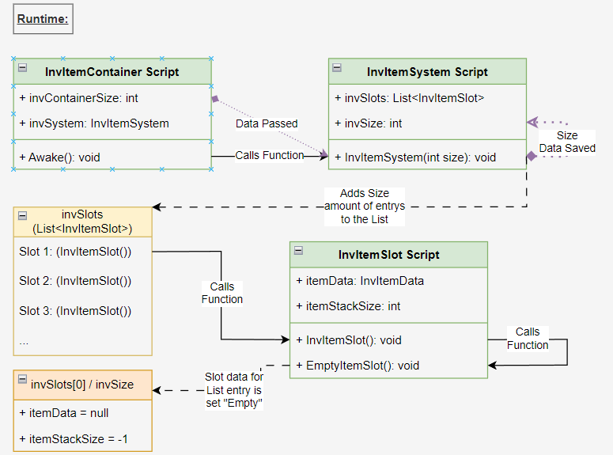
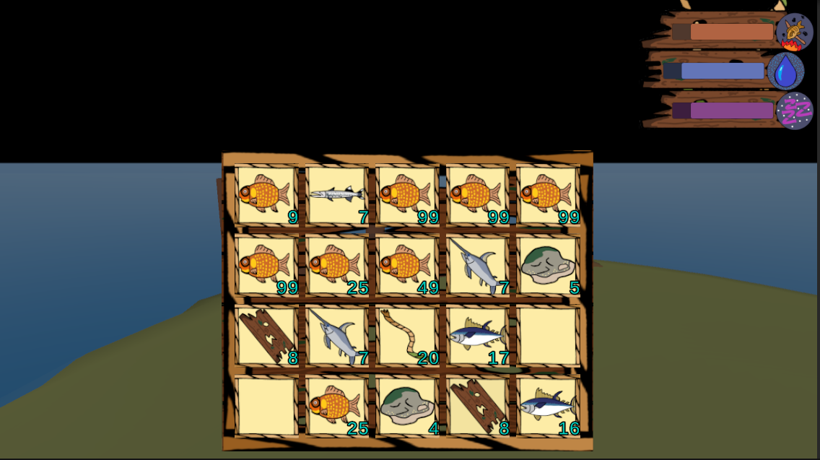
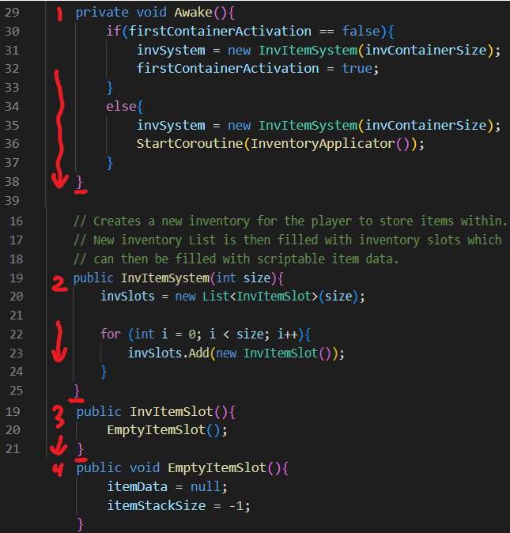
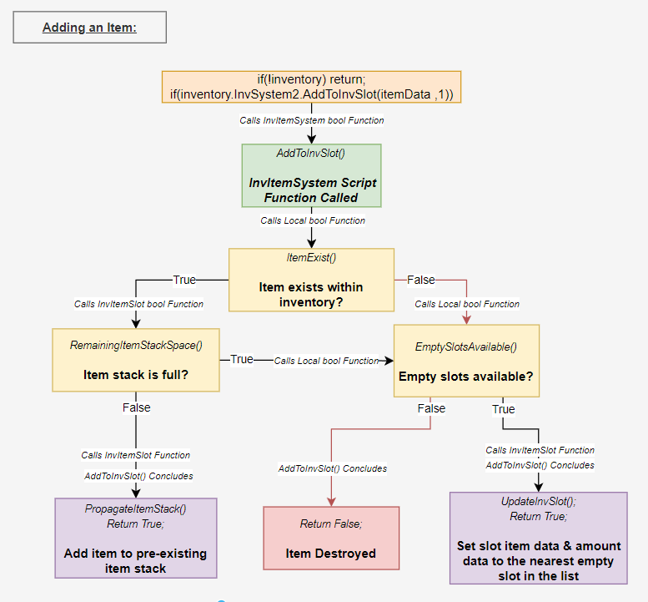
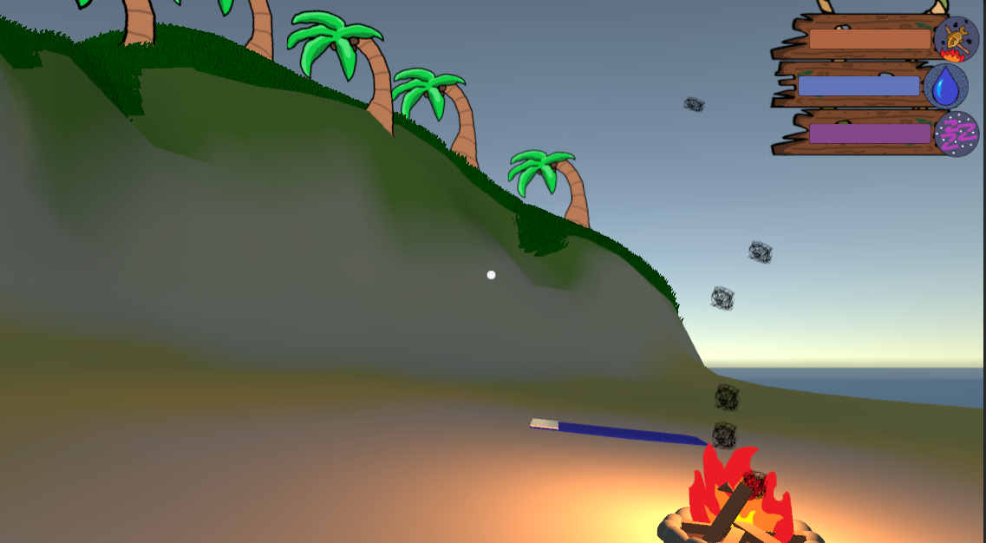
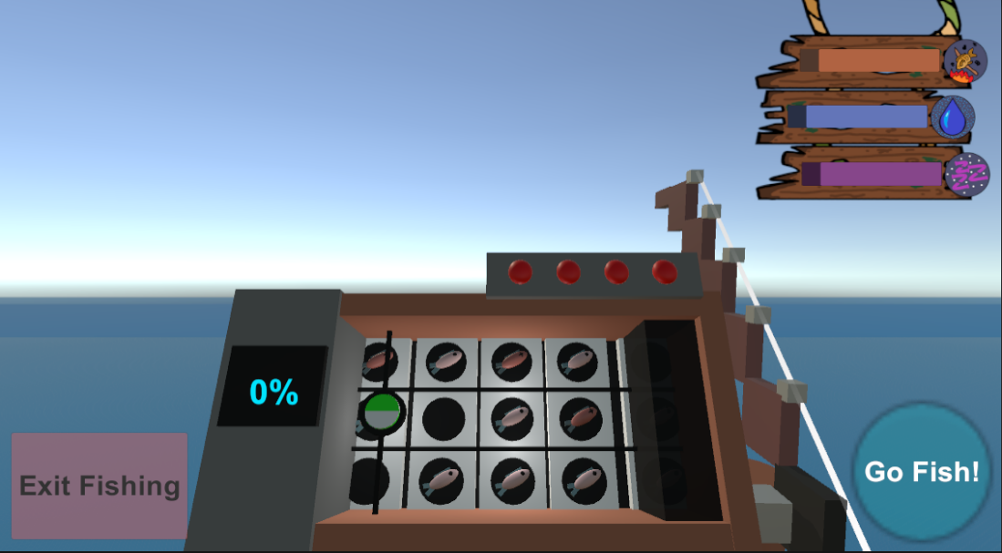
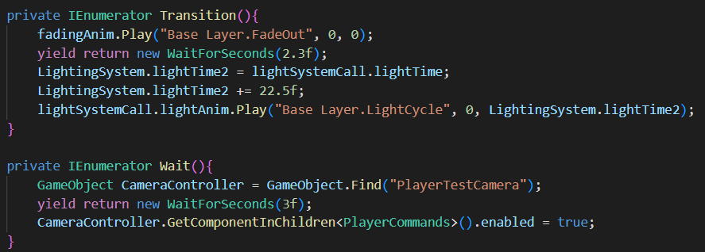
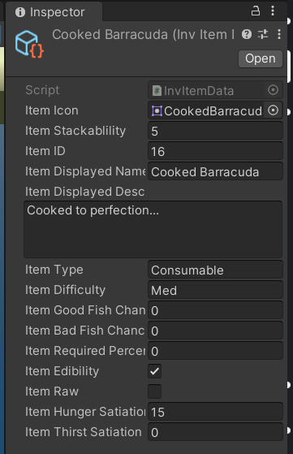
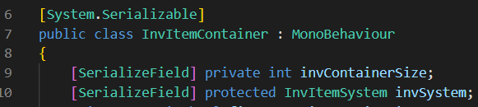
Shoals O’ Plenty
Unity Engine - Island Survival Game
Developed by: Benjamin Perryman
Senior Capstone Project, Fall 2023
Faculty Advisor: Dr. Rad Alrifai
Northeastern State University
C#
Abstract:
Shoals O’ Plenty is a small game built within the Unity game engine, a software framework used to design and build video games. My project started from the concept of being trapped on a desert island and needing to survive by fishing for different items that would either keep you alive or help you escape the island. I have only built smaller game programming relate projects in the past, and it was largely 2D games built from online tutorials. Game design and programming are two things that I am extremely passionate about, so I was very excited to be given the chance to further my knowledge and experience through a larger scale Unity project. My main goals for this project were to learn more about the Unity game engine, C# coding language, and experience firsthand the problems that a developer can run into while designing a game from scratch. While working on this project I kept a lot of sticky notes with different ideas or ways to implement said ideas, they acted as the main way to keep myself on course throughout the project. I learned through working on this project that I have trouble sticking with one specific idea and tend to produce an overwhelming number of adjacent ideas leading to slowdowns in project progress. Additionally, on the technical side, I learned how to use Unity’s ScriptableObjects, serialization, and coroutines within the Unity game engine to build a game with complex features. Each of these helped me learn how to better manage data being request and passed around throughout my code scripts. After working for so long on this project I am proud to be able to deliver a working game, even if it’s just a small demonstration. I still have a lot of ideas that could be added to it, a save/load system, more animations, or even a way to get specific types of resources would all be great additions. This project has only bolstered my excitement to work on future game programming projects, whether they are future passion projects or even retail products.
Implementation:
Shoals O’ Plenty is split up into 3 major sections, the island hub area, the fishing minigame, and the inventory system that connects them together. As seen in Figures 1, the island hub was built to give the player a place to walk around and enjoy the island theming. I wanted it to be a place where the player could relax and listen to the waves as they cook or boil water at the campfire. The fishing minigame section of the project, seen in Figure 2 is the primary place where items (ScriptableObject data) get added to the player’s inventory. By completing the minigame, the player is rewarded with either fish or resources to repair the boat. The gameplay for this section is largely built from prior knowledge with the Unity engine, but a lot of the displayed graphics and resetting the minigame are handled through coroutines. Using a mix of Unity animation events and coroutines helps this section feel fluid to play over and over. Which items you catch depends on random chance, random numbers are drawn to determine whether it’s a fish or resource, the fish’s difficulty, and which fish to pull from each respective difficulty array. The fish tokens on the gameboard seen in Figure 2 are randomly placed and their chances are derived from data pulled from the item’s ScriptableObject asset file. I wanted the fishing to feel different for every player, so a lot of it is just down to luck. Coroutines were used a lot in this section as well as the island section. I could sync up animations, sounds, and other functions while waiting for another function to complete. Coroutines within Unity scripts allow you to split a function across multiple frames, whereas usually Unity will attempt to finish a function in a single frame. They’re ability to add delay to code through “WaitForSeconds()” as seen in figure 4. This makes them well suited for creating progress bars and overall making the game feel less rigid to play. Reducing the overall rigidity makes the game feel more natural to play and creates a better experience than simply having the code run as fast as possible. Figure 3 shows the inventory UI for the inventory system. Working on this section taught me about the concept of serialization within Unity and how to use Unity’s ScriptableObjects. Serialization is the way Unity reads and understands data from within script files. Unity will serialize all data within a script unless specified not to, this comes at the cost of an increase in system memory usage. Typically, all public attributed data is serialized and accessible from other scripts and private attributed data is not, using the “[SerializeField]” attribute as seen in figure 5, we can make private data visible within the editor without letting other scripts access the data. Serialized information is displayed inside the Unity Editor, the virtual development environment for Unity. Having your private data visible from the editor helps developers keep track of information and to see if their code is functioning properly without the chance other scripts accidentally accessing private data. Being able to see what all was happening with my data helped speed up my project’s development. ScriptableObject files are primarily used as a different way to store data externally from variables within script files. Through their use we can reduce the necessary amount of system memory used while running our game as instead of coping the same variable data multiple times into memory, we can copy the ScriptableObject data once and reference when needed. The inventory system takes the data stored within these asset files and applies them to inventory slots when requested, the ScriptableObjects are in essence the items themselves. Figure 6 shows an editor view example of an item from my project along with all the different data stored within. Each inventory slot contains 2 things, the item’s data and how many of that item it can hold. Both are information stored in the ScriptableObjects files, for this project they contain vital information regarding how much hunger they restore and other data like their capture requirements for the fishing minigame. Each time a level is loaded the inventory system creates a fresh instance of an empty inventory before adding in the items that were there previously, if any. Figures 7a, 7b, and 8 provide visual aid for understanding how these process function, the way data moves through the scripts, as well as the logic behind the two most important functions of the inventory system. Items can be added, removed, and used by the player to accomplish multiple tasks within the game, eating food, drinking water, and giving resources to the boat repair menu to reach the next stage of construction. The inventory system is vital for staying alive and winning the game, without it I wouldn’t be able to deliver the experience I was trying to make.
Implementation Continued:
Figure 7a: UML Class Diagram of: Inventory at Runtime
Introduction:
Shoals O’ Plenty was a test of my ability to stay on track with a large-scale project. I wanted to see how difficult it was to build a video game with all the knowledge I had attained from my years at NSU. Said knowledge alongside some new concepts and code learned during the project’s development have gone a long way in helping me reach an end point that I can be happy with. I’ve always had a huge interest in the way video games are made. The idea of so many different people combining their creative ambitions to produce something for all kinds to enjoy is fascinating to me. It’s inspired me in the past to put more effort into my game programming projects and it’s inspired me this semester to pick a game programming related project to cap off my senior year at NSU.
Fig 3: Inventory UI Screenshot:
Figure 7b: Inventory at Runtime Code Snippet
Figure 8a: UML Activity Diagram of: Adding Inventory Item
Fig 1: Island Hub Gameplay Screenshot:
Fig 2: Fishing Gameplay Screenshot:
Technology:
The technologies I used for my project was the Unity game engine, a software framework designed for the creation and development of video games. Unity is an incredibly versatile framework that can build 2D games, 3D games, Augmented Reality (AR) games, Virtual Reality (VR) games, and even non-game related software. Unity provides developers with a lot of tools and add-ons to make developing a game as easy as possible either by using the Unity Package Manager or by visiting their online marketplace, the Unity Asset Store. Documentation of the game engine is all online and continues to update regularly, providing in-depth explanations on different game development concepts and coding examples. Additionally, I found the Unity Forum to also be a great way to find solutions and common consensuses on Unity project proceedings.
Conclusion:
This project was meant to serve as a test of my knowledge and experience gained through my years of work at NSU. This project helped teach me more of the innerworkings of the Unity game engine as well as help me gain more experience with C# programming. I learned how to manage tasks within a large-scale project and even how to keep motivation high during stressful project management. Lastly, I gained a lot of experience from building my own game from scratch, I learned how to better overcome the challenges associated with game programming and game design. I am proud of what I was able to make in such a limited amount of time and am looking forward to my next future projects, whenever I get around to them. It could even be continuing work on Shoals O’ Plenty, there are a lot of places for potential expansion and improvement. I would love to put together some better UI for the project, what it has now is fine, but it’s not very professional looking. One of the first ideas I had for this project was to let the player spend resources to upgrade the campfire to cook and boil water faster, other potential upgrades systems could be a cool way to give the player some other reasons to collect wood, rope, and rocks. I’d love to learn more about system flags and Enums, so those might be part of my next bit of research for Unity. Though I may want to look towards other game engines as well since Unity Technologies has been constantly making poor decisions as of late. Even still, this project has only reassured me that this is something I want to do in the future, whether it be for passion or as a job.
Method:
My methodology for this project was to start exploring solutions whenever a problem would arise. If I were to get stuck trying to work out how a certain feature would function, then I would start researching how other developers and Unity users would accomplish similar features. I did not want to waste time studying Unity documentation that wouldn’t prove useful, so I adapted new solutions as the project progressed. When it comes to creative projects like this, it takes me far too long to plan out everything in advance while also implementing said plans. I find it a lot easier to learn as you make progress and use short term goals to pave a solid path forward. Having a free-flowing plan can really boost the motivation to continue working as you produce new ideas to potentially add next. Another way to help split up a project’s overall workload is to have milestone checkpoints. For my project some of the milestone checkpoints were smaller objectives like finishing the cooking/boiling functionality of the campfire. So, while I would have a specified checkpoints to mark project progress, the way I would reach that checkpoint was to simply work on it until I believed it was finished, implementing whatever new code or tools were necessary for completion. I would write down a lot of my plans or implementation ideas on sticky notes to have small reminders of what I’ve thought about and need to do next. Having a physical reminder helps me remember and catalog ideas better than a digital list, plus its fun to see how big the pile of sticky notes becomes by the end of the project.
Fig 4: Fade Animation Coroutine Code Snippet:
Fig 6: ScriptableObject Screenshot:
Resources:
Unity: https://unity.com/ Unity Manual: https://docs.unity3d.com/Manual/index.html Unity Forum: https://forum.unity.com/ Unity Logo: https://unity.com/legal/branding-trademarks Dan Pos YouTube Channel: https://www.youtube.com/@DanPos Inventory System Tutorial(Long Video Ver.): https://youtu.be/zASeJxFUG58?si=uxPtHBtL05zX4UXQ Pixabay Sound Effects: https://pixabay.com/sound-effects/
Fig 5: Serialization Example Code Snippet:

